Slide 1


MEDICAL EXPERT
Software Engineering Project
RITIK SINGH 2K19/CO/319

Slide 2

OUTLINE
Introduction
Objective & Motivation
Hardware & Software Requirements
Responsibilities
Flow Chart
Implementation Screenshots
Challenges
Limitations & Future Enhancement
References
Software Engineering Project

Slide 3
INTRODUCTION
My Software Engineering Project is an Android Application Named as “MEDICAL EXPERT”
\
It is a Health App
Software Engineering Project

Slide 4
MOTIVATION
In today’s rush, it is difficult to get a Doctor’s Appointment in case of Emergency.
To Get List Of Diseases based on Symptoms entered by User.
To Get Locations Of Nearby Hospitals.
To Call Family / Ambulance In Case Of Any emergency
OBJECTIVE
Software Engineering Project

Slide 5
MINIMUM CONFIGURATION
SOFTWARES
Android Studio
JDK 11.01
HARDWARES
3 GB Ram Minimum (8 GB Recommended)
3 GB Disk Space Minimum (900MB for IDE & 2GB for SDK & Emulator )
Minimum i3 Processor
Software Engineering Project

Slide 6
RESPONSIBILITIES
UI Design
Data Collection
Backend
Google Maps Module
Call & Mail Module
Software Engineering Project

Slide 7
FLOWCHARTS
Medi Consult
Disease Checker
Nearby Hospitals
SOS Call
SHARE
CONTACT US
Software Engineering Project

Slide 8

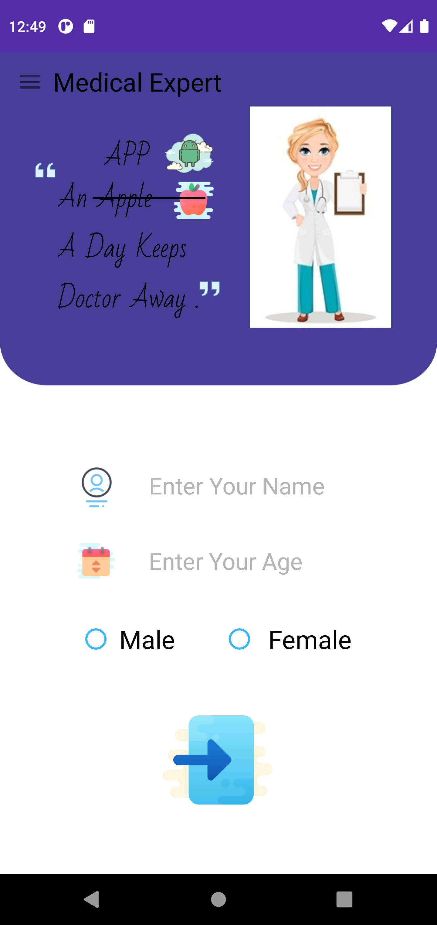
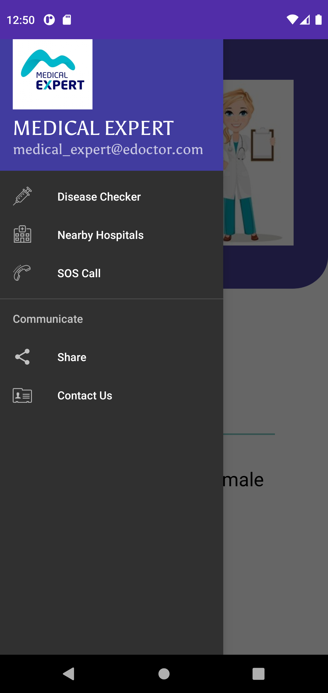

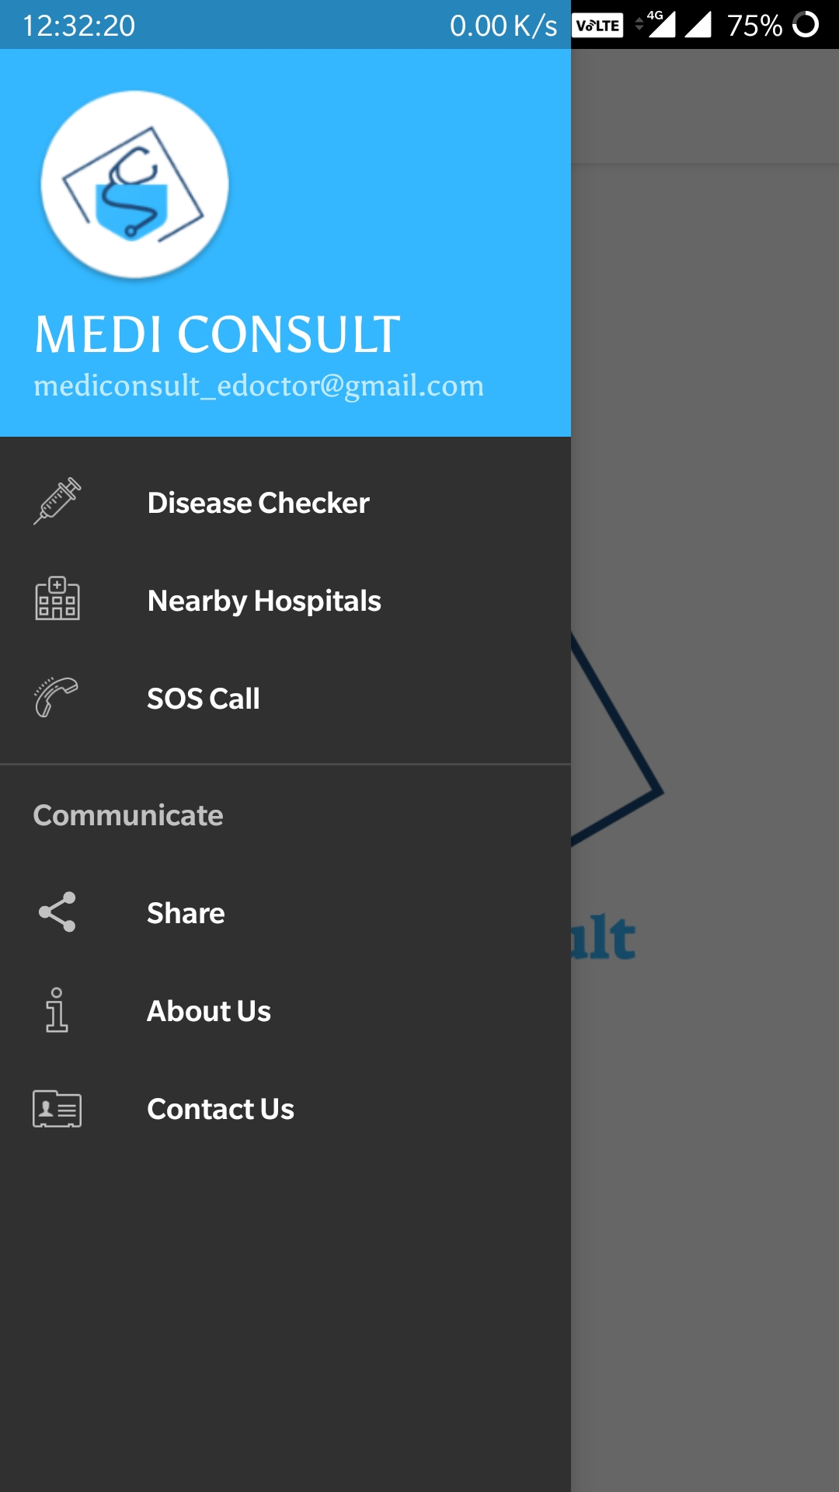
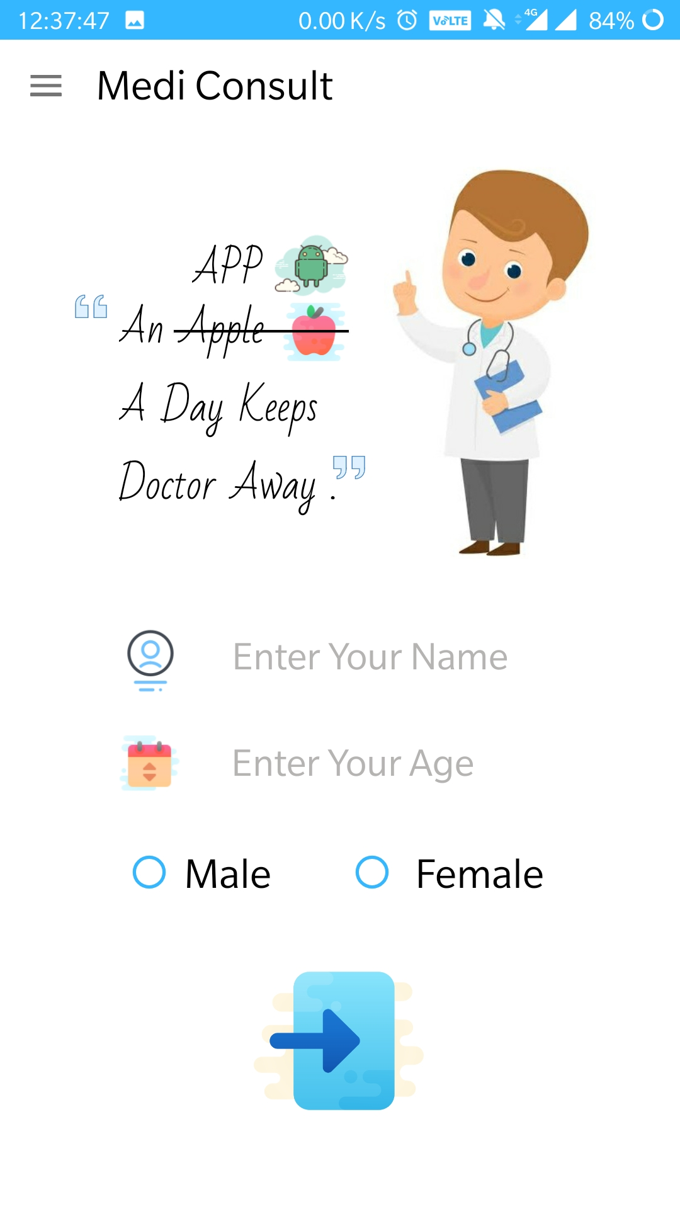
IMPLEMENTATION SCREENSHOTS
Software Engineering Project

Slide 9
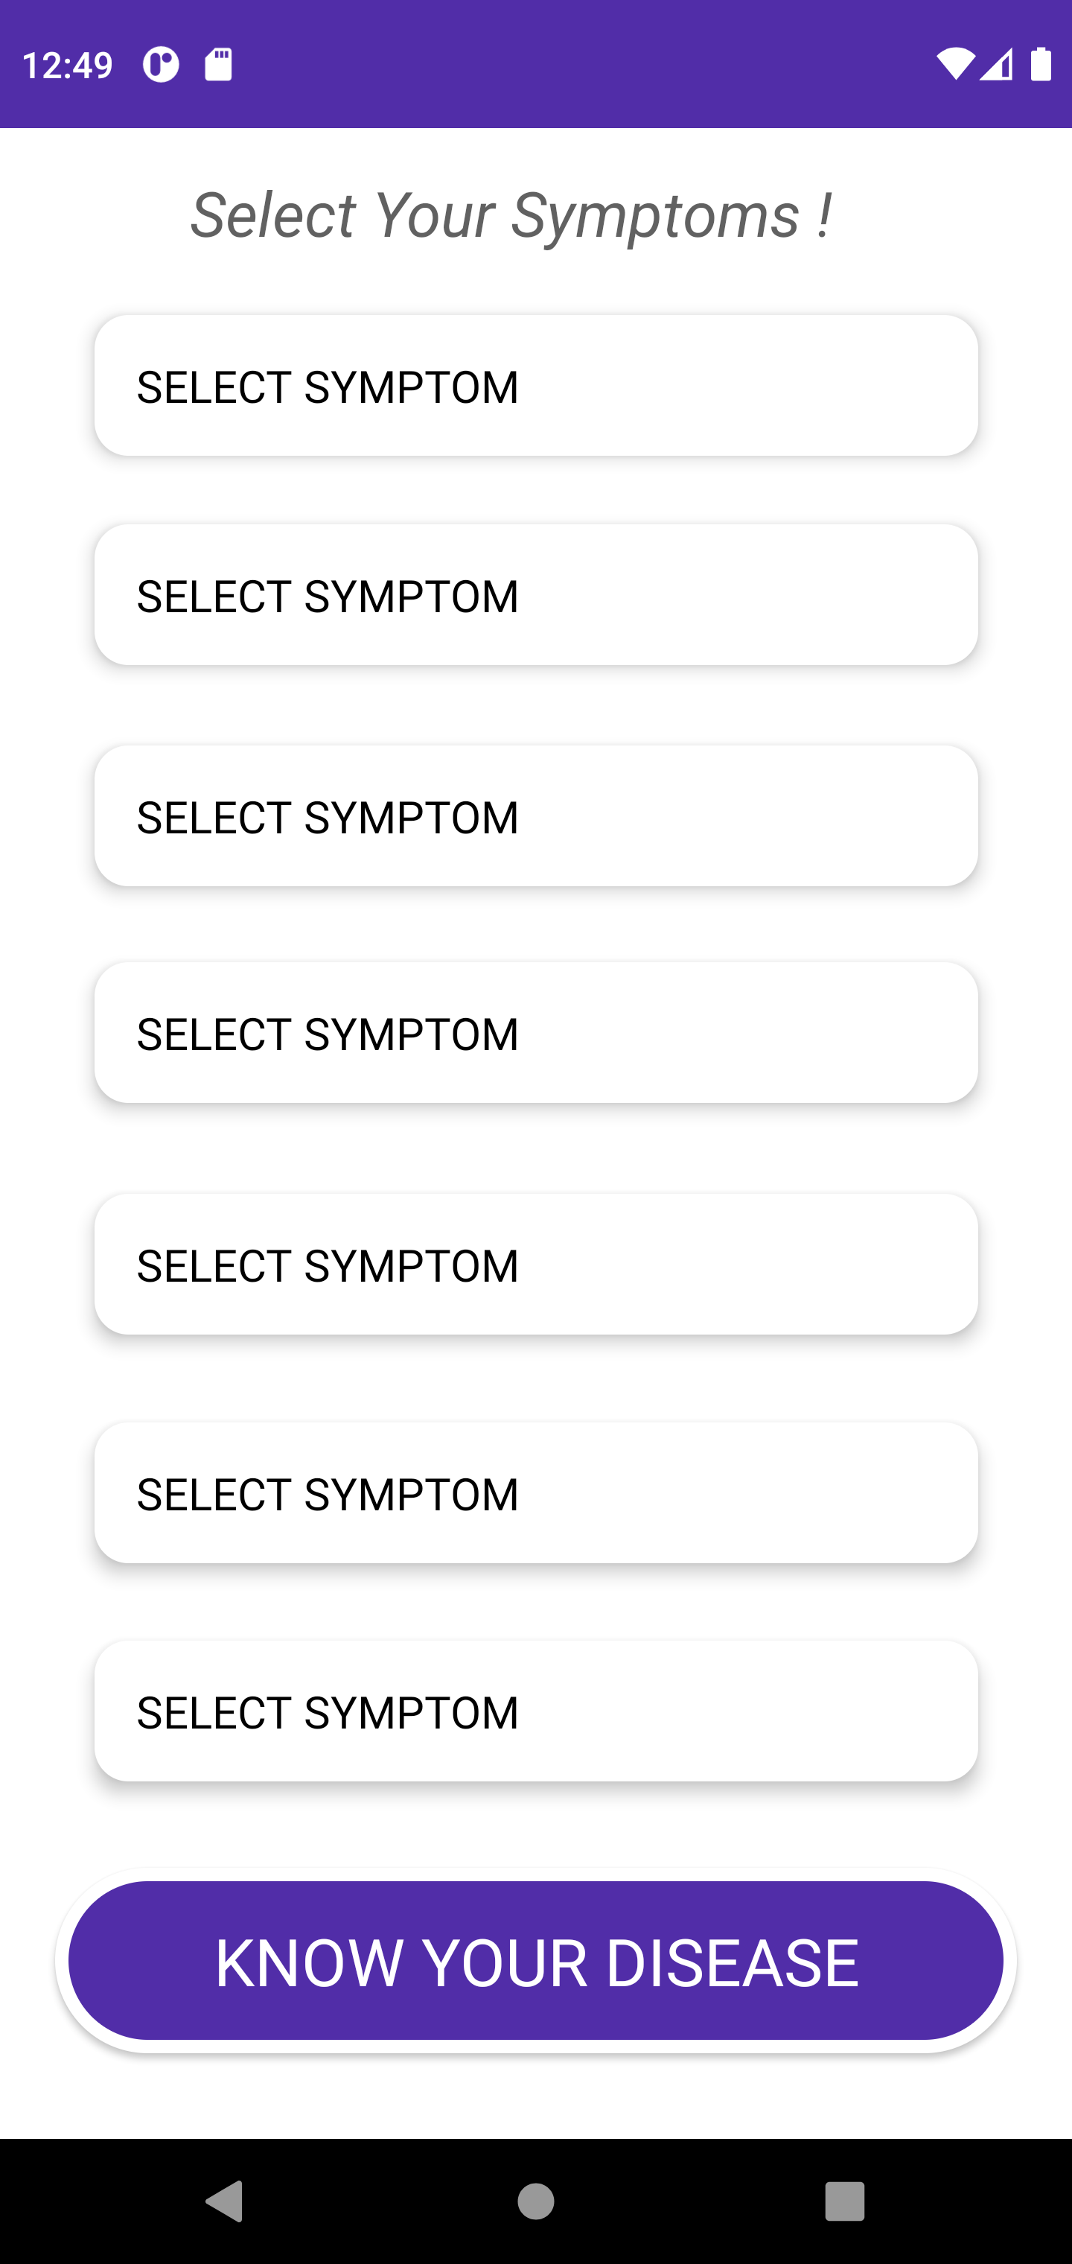
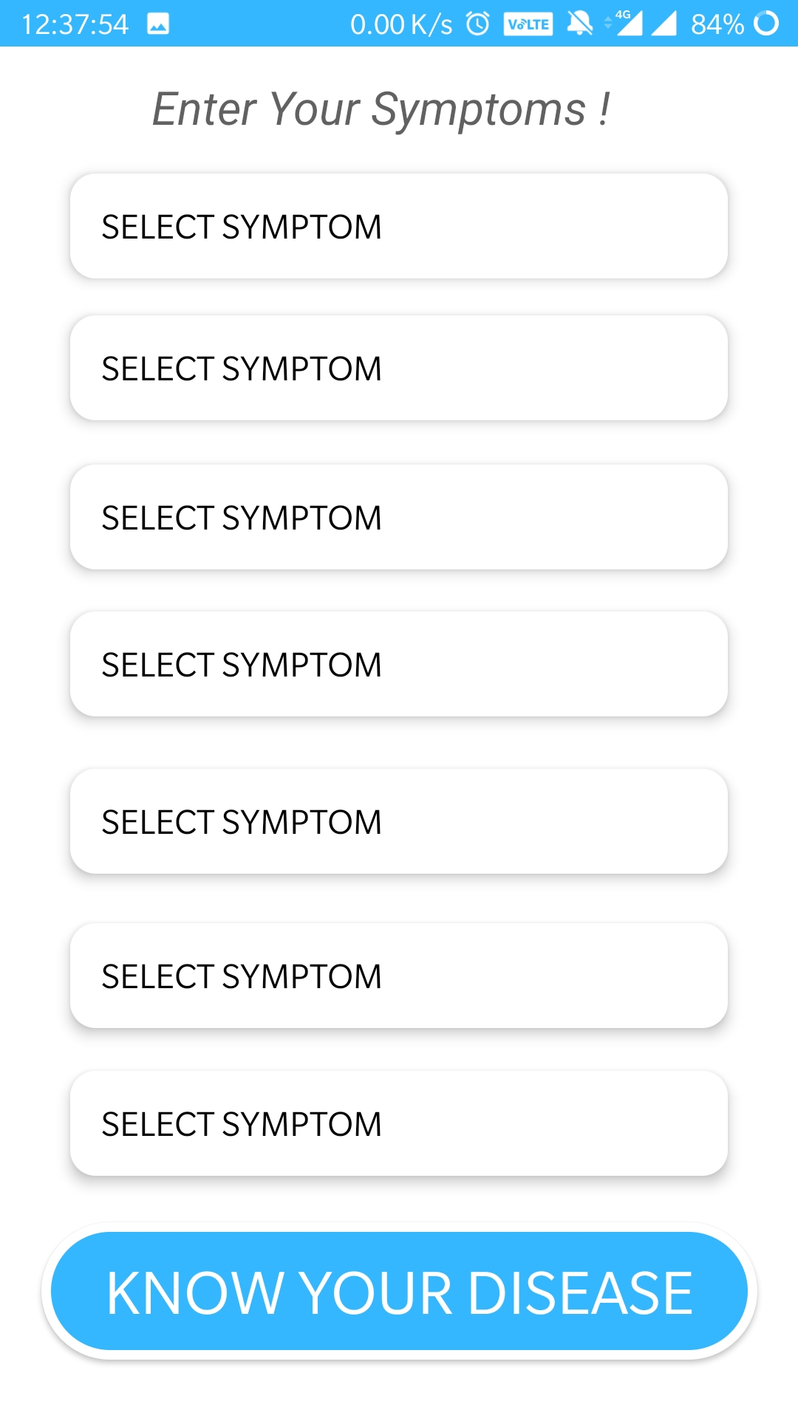
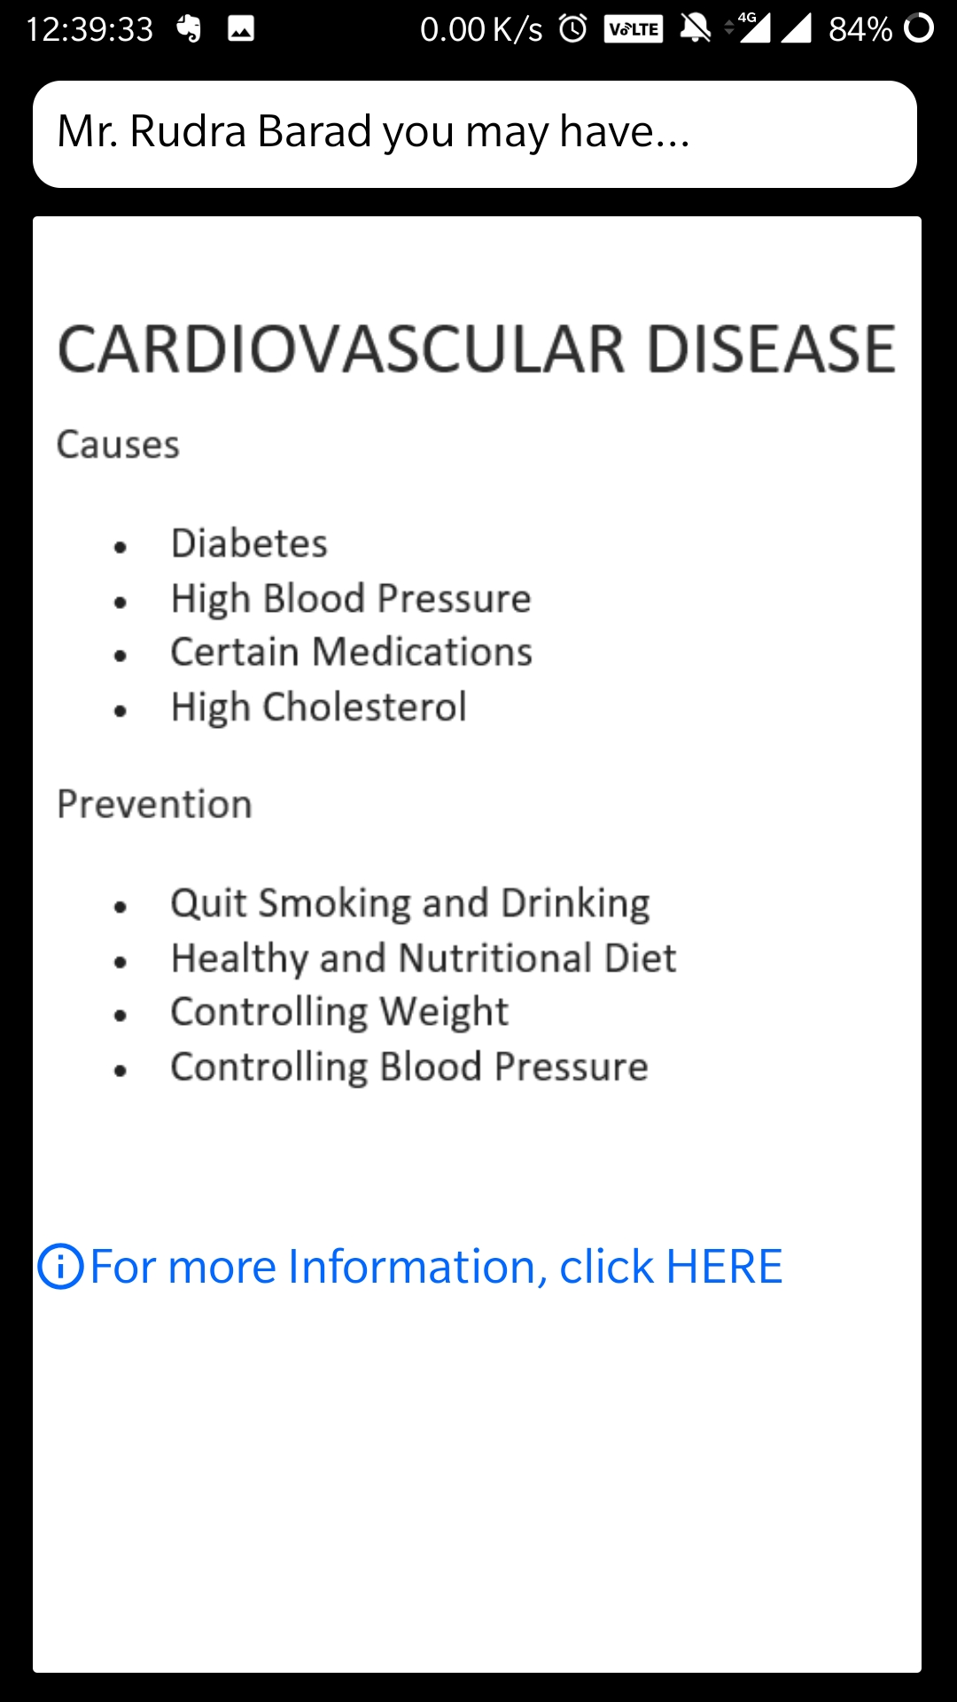
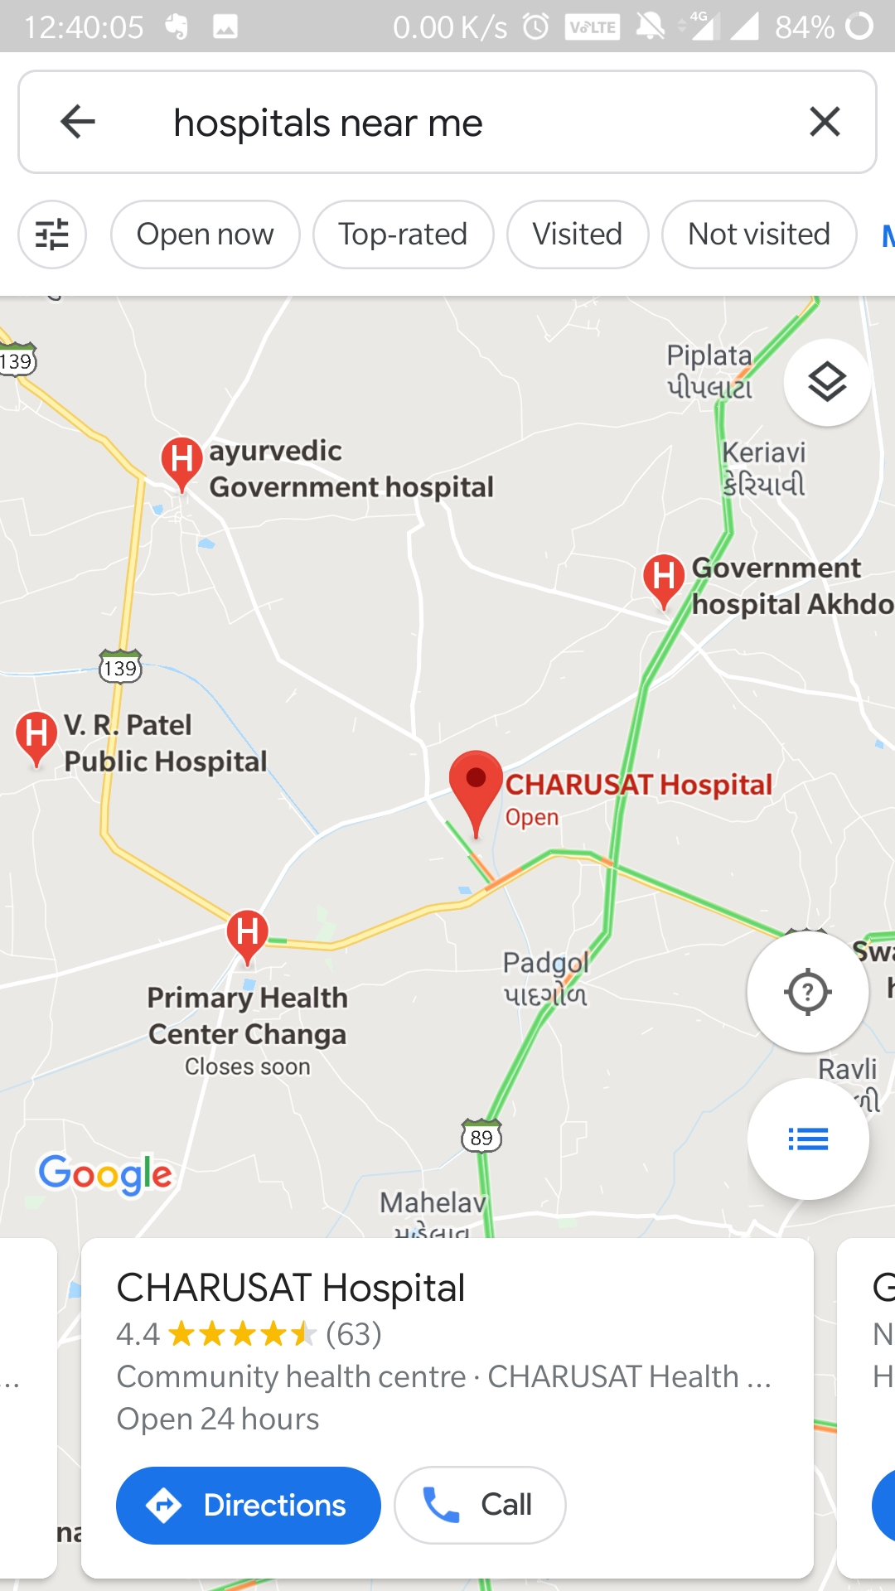
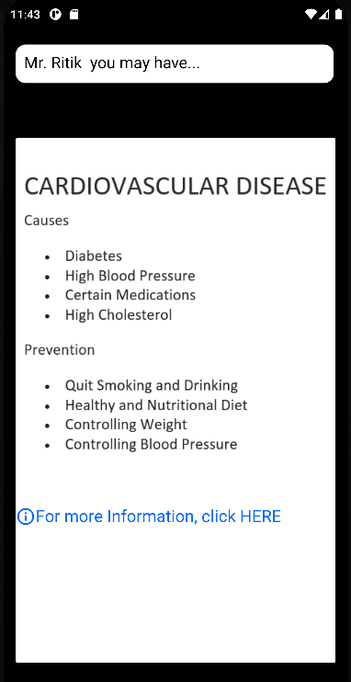
Software Engineering Project

Slide 10
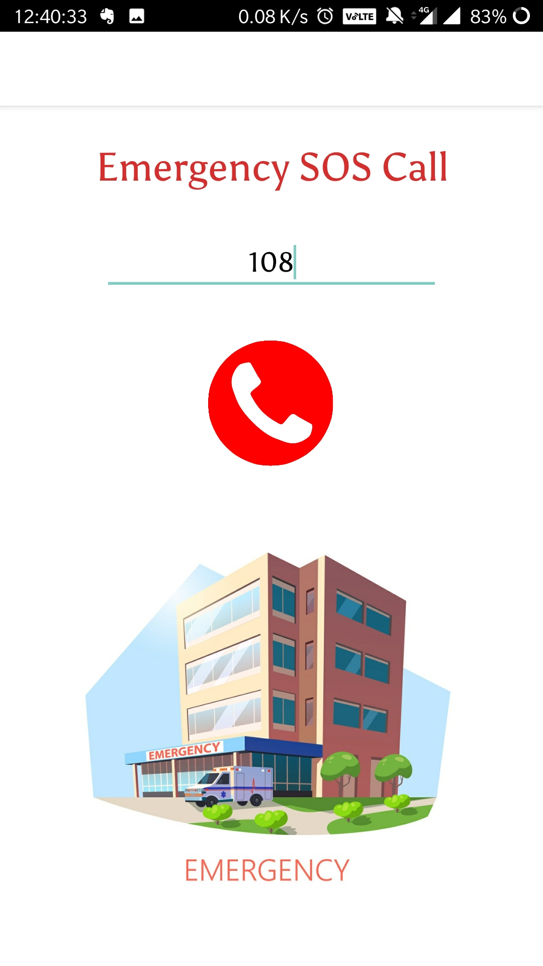
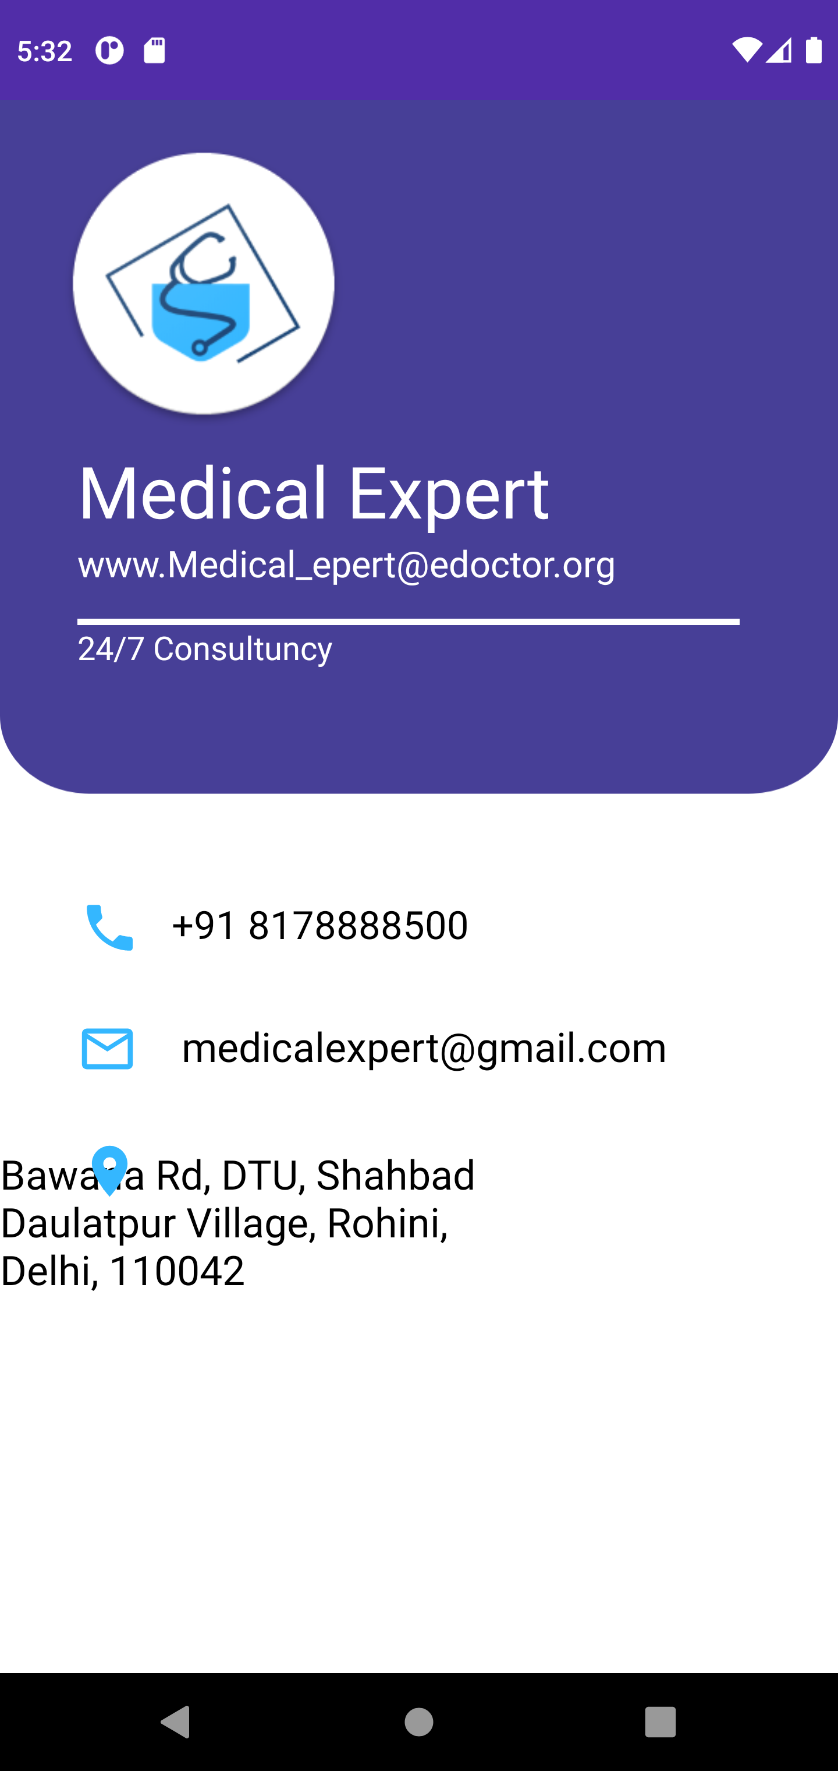
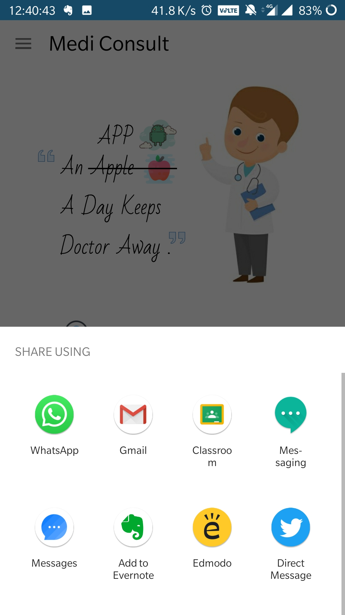
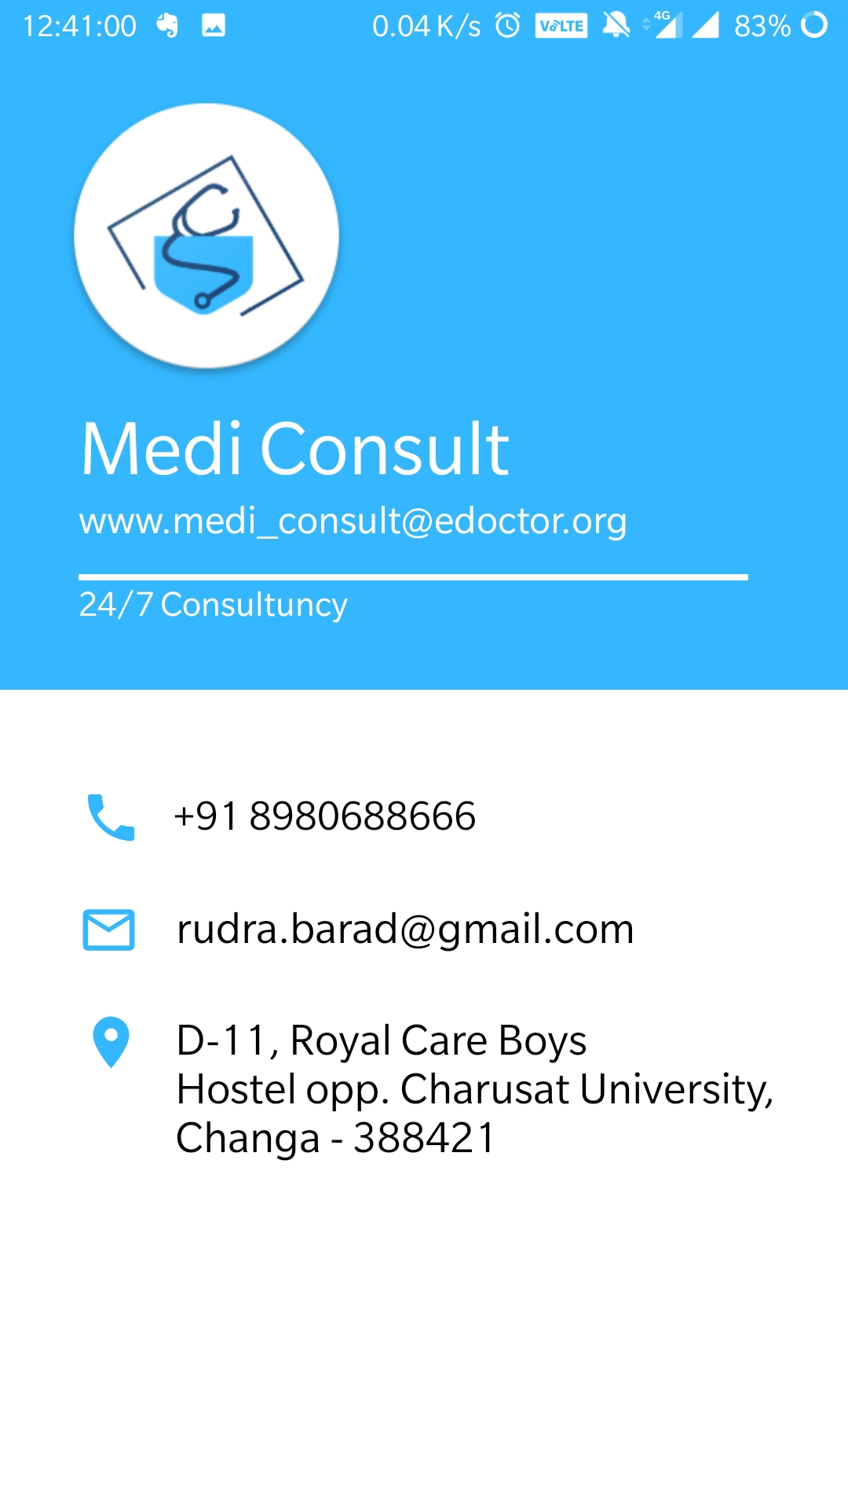
Software Group Project

Slide 11
CHALLENGES
Learn a Different Application Like Android Studio from Scratch.
Changing Dependencies Of Android Studio caused Immense Difficulty.
Updating Gradle File and Version of Android Studio.
Asking Permission for Calling while Implementing SOS Module.
While implementing Gmaps API for nearby Hospitals.
Software Group Project

Slide 12
LIMITATIONS &
Does not Cover up all the Diseases, as it will need ML as well as large Database.
I have just prepared a Prototype.
FUTURE ENHANCEMENT
To Obtain Information and contact details of Doctor concerned to your Disease.
To Cover Up All the Diseases.
To Suggest / Advice few basic Medicines for a Disease.
Software Group Project

Slide 13
REFERENCES
https://developer.android.com
https://www.youtube.com/watch?v=UDwj5j4tBYg
https://www.youtube.com/watch?v=fGcMLu1GJEc
https://www.youtube.com/watch?v=nxSdkiFcQxs
Software Group Project

Slide 14
THANK YOU
Software Group Project

